Slide 1
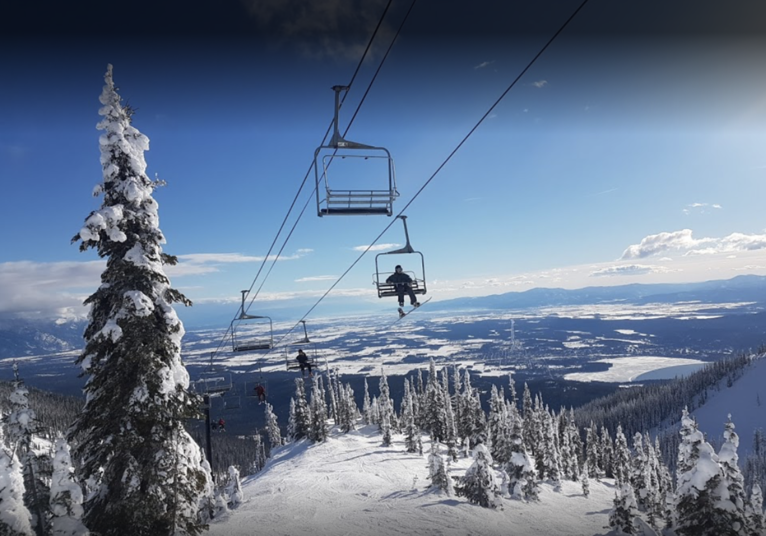
Big Mountain Resort Pricing Analysis

Slide 2
Problem Identification
Big Mountain Resort uses a simple pricing strategy for their ski ticket prices.
Big Mountain Resort charges a premium above the average ticket cost in this market.
Big Mountain Resort charges $81 per Weekend Ticket and management would like to know if there is an opportunity to increase ticket prices or reduce costs to improve resort profitability.

Slide 3
Key Findings and Recommendation
Our model indicates that Blue Mountain Resort is underpricing it’s ski tickets. Based on Blue Mountain Resort’s facilities and ski characteristics, Blue Mountain Resort can support a $94 ticket price which is 16% above the current price of $81
We do not recommend increasing prices this dramatically in one season.
Instead we recommend that Management increase ticket prices by $2 for this upcoming season and monitor results and client feedback.

Slide 4
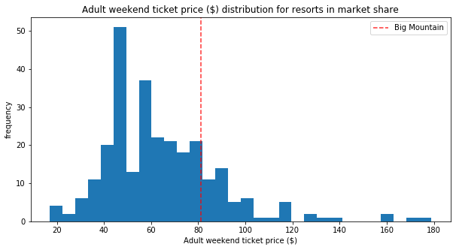
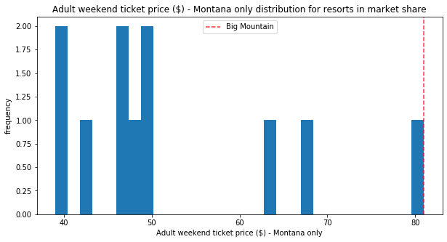
Modeling results and Analysis
Compared to other resorts in Montana, Big Mountain charges the most out of 11 resorts
However when we compare Big Mountain to all resorts in the U.S, we see the are not the most expensive. How can these resorts charge more than $80?

Slide 5
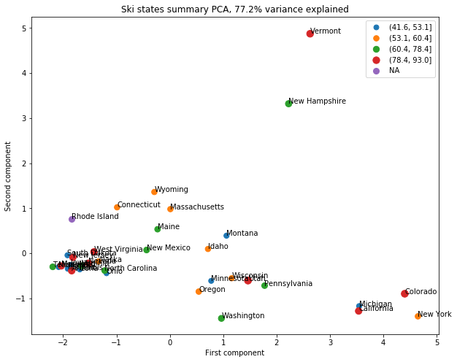
Modeling results and Analysis
Does the state in which the resort reside in determine price?
Answer: We do not see a pattern between pricing and State
This suggests that we can compare ski resorts across all states and we do not need to only focus on Montana
Just because Big Mountain charges the highest ticket price in Montana, this is not a constraint on further increases

Slide 6
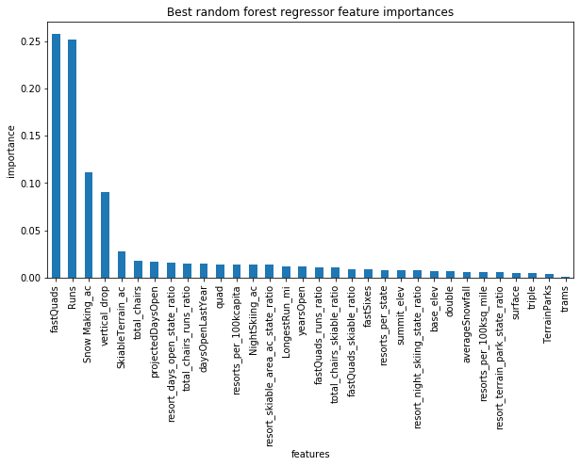
Modeling results and Analysis
So if State the resort resides in doesn’t drive pricing what does?
Some important variables include:
Number of Fast Quad lifts
Number of Runs
Amount of Snow Making acres
Vertical Drop
Amount of Skiable Terrain
Number of Chair lifts

Slide 7
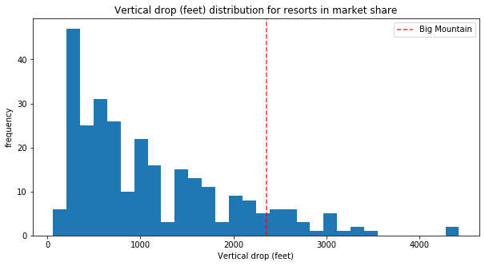
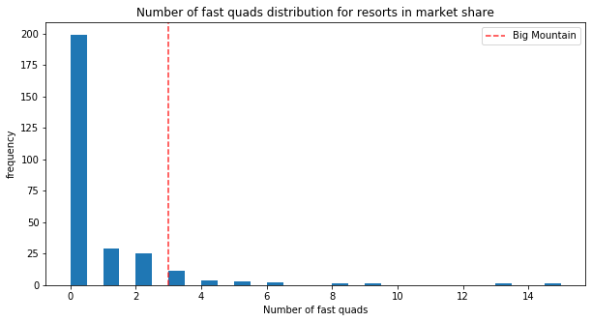
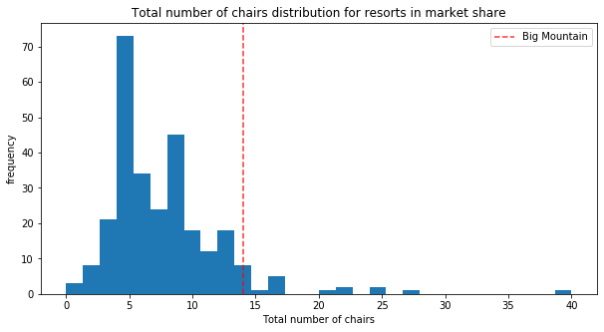
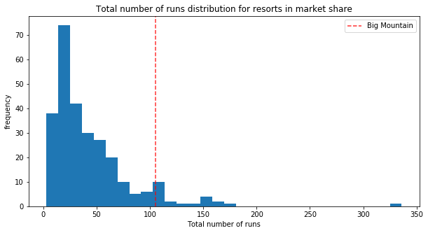
Modeling results and Analysis
Many of the ski mountain characteristics and resort facilities that drive pricing, Big Mountain Resort scores favourably versis the market.

Slide 8
Summary and Conclusion
Based on mountain characteristics and facilities, our model suggests ticket increase to $94.
However, our model does not consider operational costs, other streams of revenue that a resort can earn, so ticket prices data does not fully represent the market’s overall pricing strategy.
With that said, we do have sufficient evidence to support a modest price increase and we suggest increasing ticket prices by 2.4% to $83 dollars which will generate an increase in revenue of 3.5MM*. This will cover the increased operational cost of adding a new chair lift recently.
We suggest observing the market’s reaction to this increase in ticket price before considering investing in upgrading the facilities. We also recommend capturing additional data on visitor stay to obtain a holistic view of customer spend at the resort as this is the metric we would like to maximize.
* Based on 350,000 visitors per year with an average stay of 5 days

